Slide 1
New Hampshire Employment Security
Economic and Labor Market Information Bureau
About us:
NH Employment Security (NHES) is a federally funded state agency.
The mission of NHES is to:
Operate a free public Employment Service through a statewide network of Job and Information Centers, providing a broad range of assisted and self-directed employment and career related services, and labor market information to all customers.
Pay Unemployment Compensation benefits in a timely manner to eligible claimants and collect the tax which funds these payments.
Develop and disseminate labor market information and provide measurements of labor market outcomes to assist local and state officials, private employers, educators and trainers, and the public in making decisions which promote economic development and the efficient use of state labor resources.

Slide 2
What is Labor Market Information?
A labor market is the relationship between workers, who are engaged in producing goods and providing services, and employers, who compensate the workers for engaging in work activity. This marketplace can be municipal, statewide, national, or international.
Labor market information, or LMI, is the body of data available about a particular labor market and its participants.

Slide 3
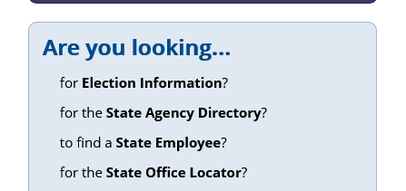
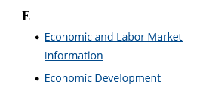
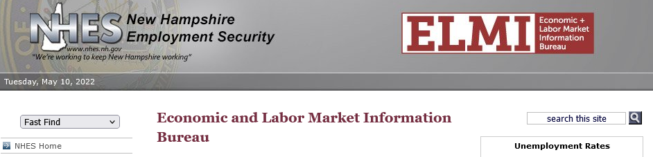
How to find us on the web
Go to NH.gov, under Are you looking..., select State Agency Directory, then click on or scroll down to E. Economic and Labor Market Information is the first entry.
Go to New Hampshire Employment Security at https://www.nhes.nh.gov/and select the Data and Statistics option (far right side of the header).
Go directly to the ELMI web site at https://www.nhes.nh.gov/elmi/

Slide 4
Questions?
General Information elmi@nhes.nh.gov or 603-228-4124
Katrina Evans, Assistant Director 603-229-4370 e-mail: Katrina.J.Evans@nhes.nh.gov
Want to know what’s new?

